Slide 1
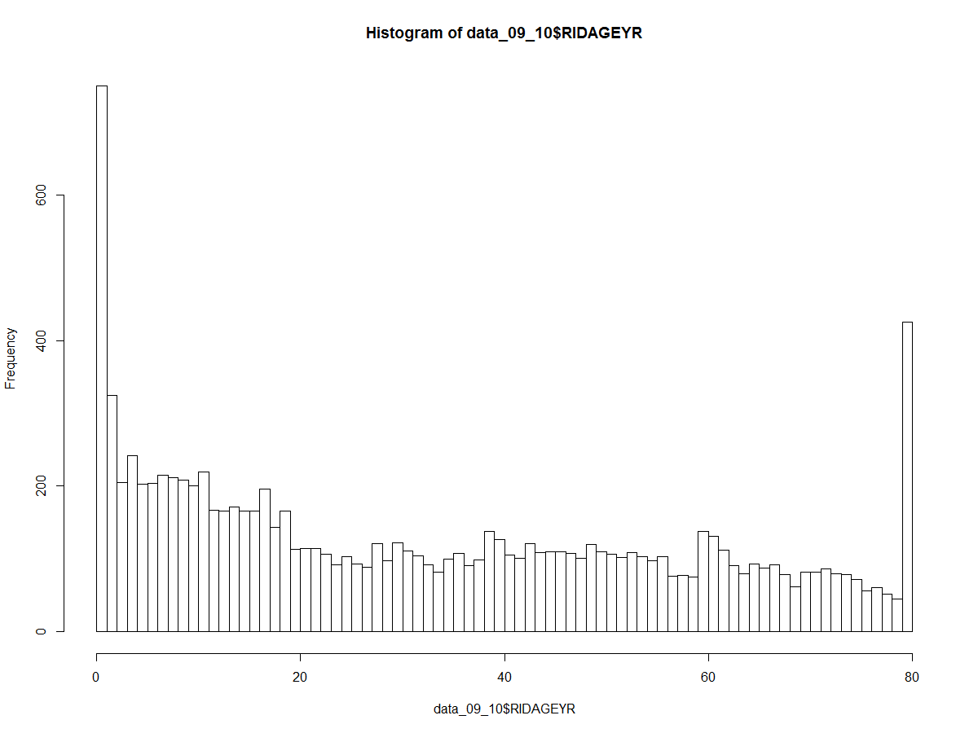
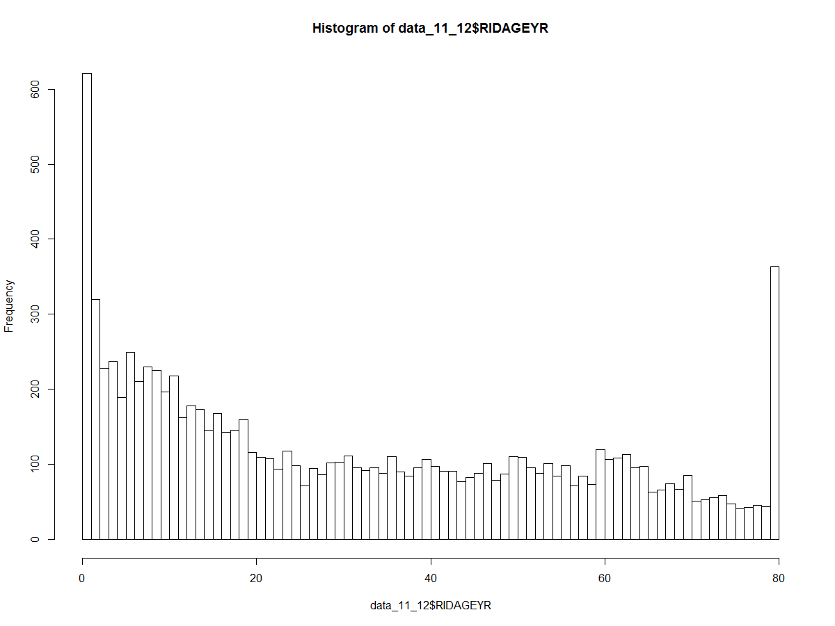
NHANES: Demographics
Age histogram for 2009-2010 and 2011-2012
n=10537
n=9756

Slide 2
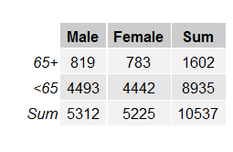

NHANES: Demographics
2009-2011
2011-2012

Slide 3


NHANES: Self-report hearing
9756 -> 9364

Slide 4
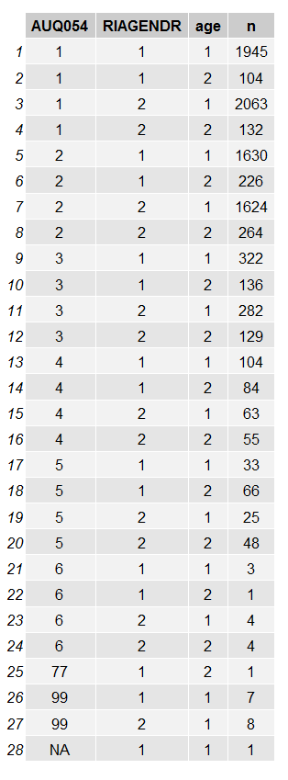
NHANES: Self-report hearing
AUQ054
1=Excellent
2=Good
3=A little trouble
4=Moderate hearing trouble
5=A lot of trouble
6=Deaf
77=refused
99=Don’t know
Gender
1=male
2=female
Age
1= <65
2= 65+

Slide 5
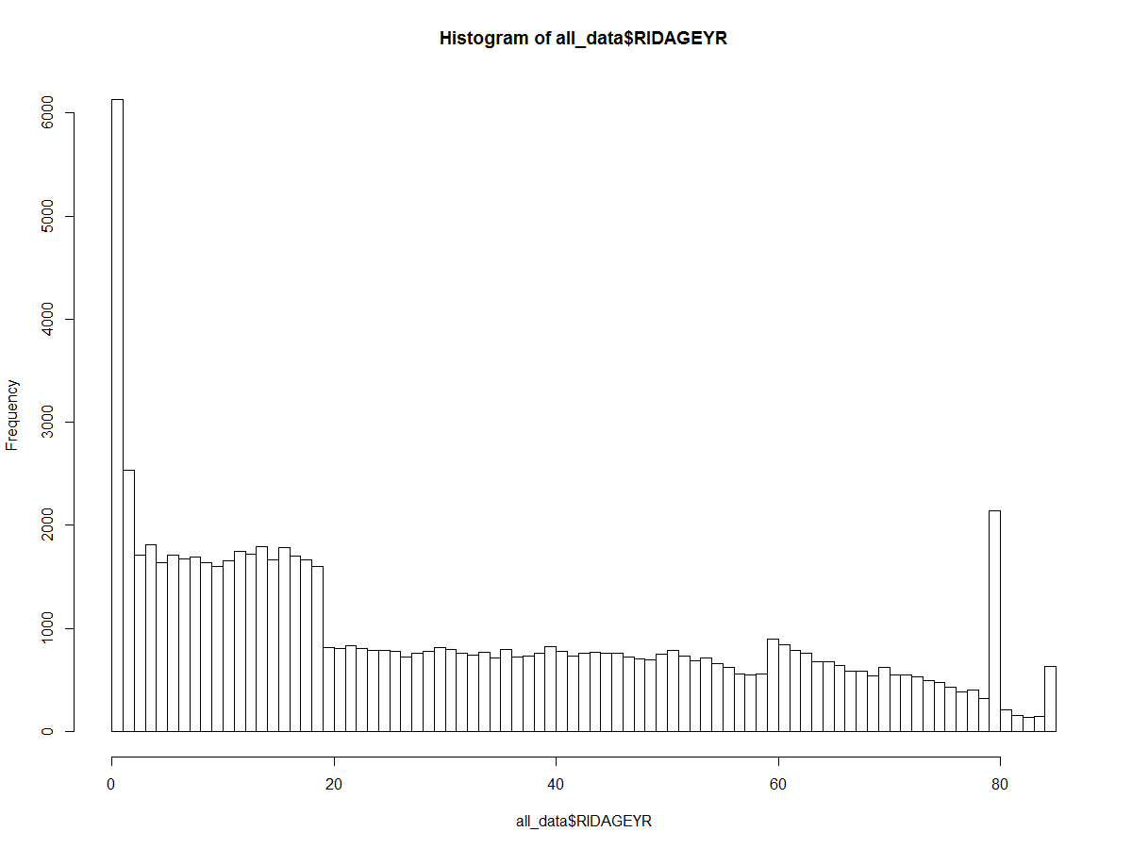
NHANES: Demographics
Age histogram for all years

Slide 6

NHANES: Demographics
All years

Slide 7
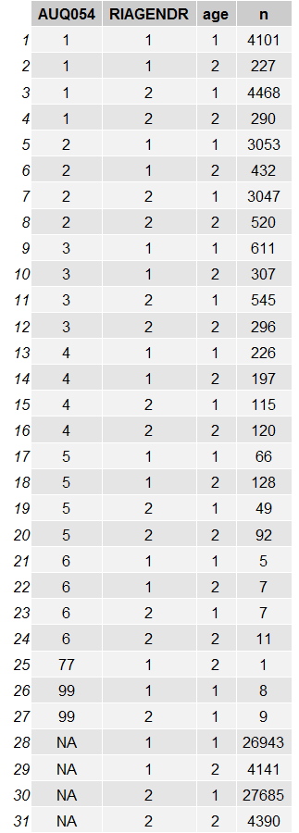
NHANES: Self-report hearing, all years
AUQ054
1=Excellent
2=Good
3=A little trouble
4=Moderate hearing trouble
5=A lot of trouble
6=Deaf
77=refused
99=Don’t know
Gender
1=male
2=female
Age
1= <65
2= 65+

Slide 8
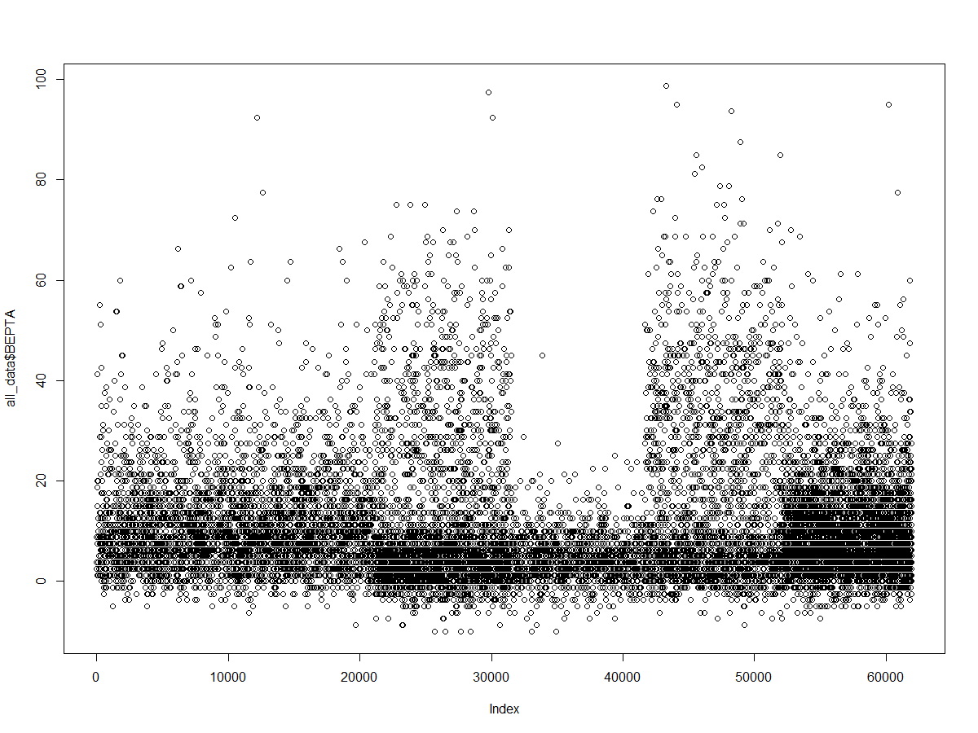
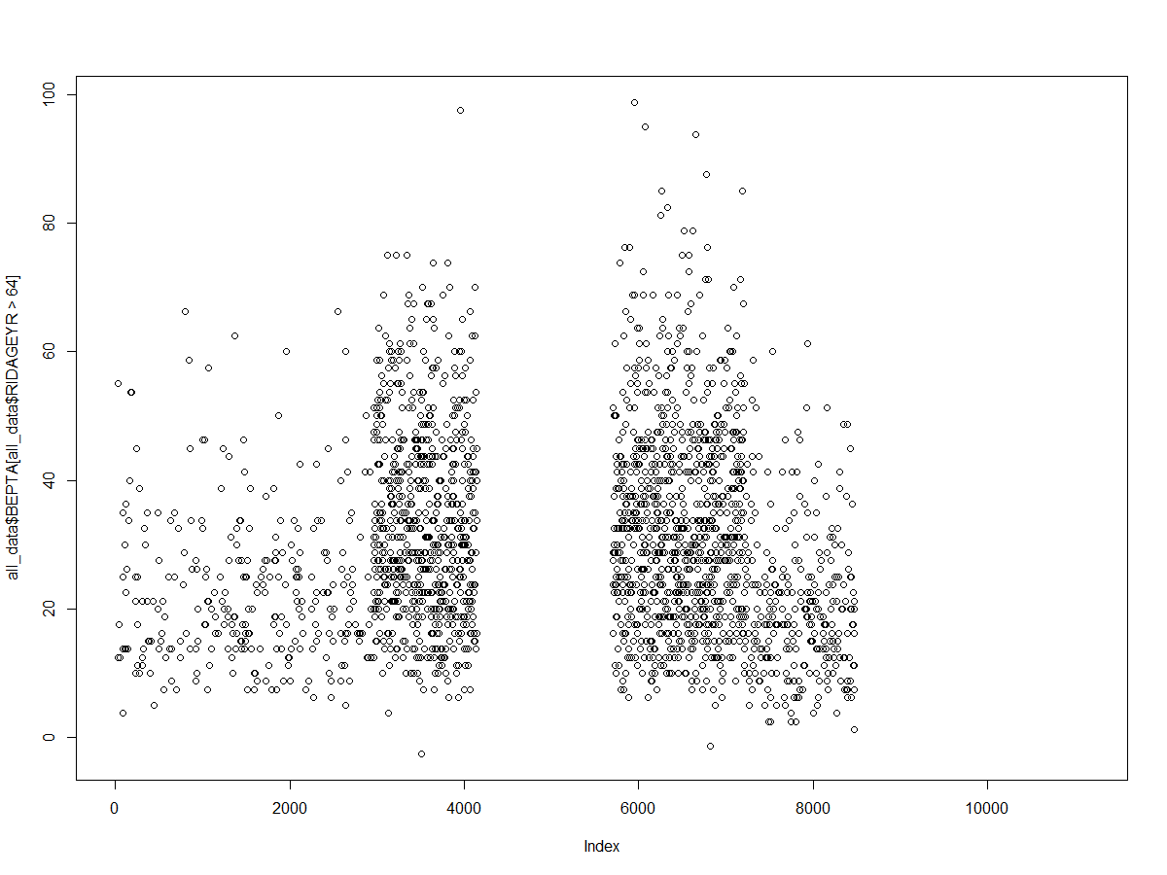
BEPTA >65 years
BEPTA all ages
n=13497
n=2226

Slide 9
